Slide 1

Using PySpark – MLlib For a Binary Classification problem with Imbalanced Classes
GAUTAM RAMASAMY (GXR180003)

Slide 2

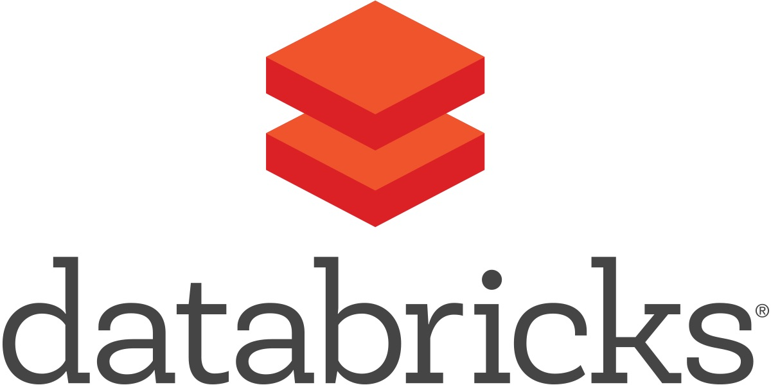
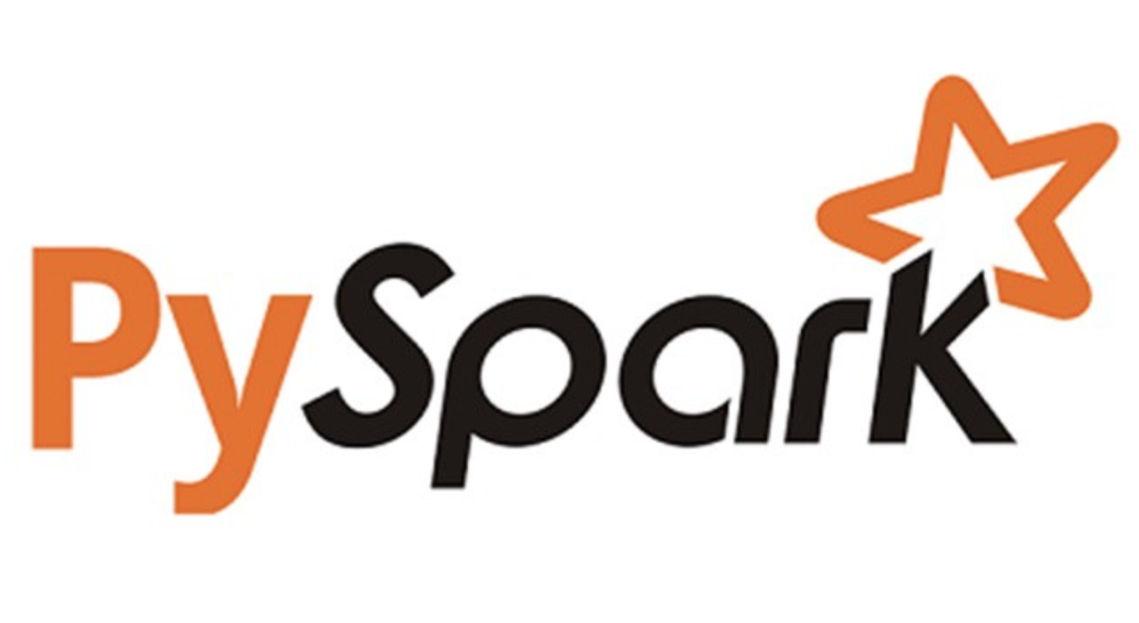
Project Description
The main objective of this project is to identify if loan applicants can repay their loans based on the data collected from each applicant.
The target variable is either 0 (applicants who were able to pay back their loans) or 1 (applicants who were NOT able to pay back their loans).
It is a binary classification problem with a highly imbalanced target label.
The distribution ratio is close to 0.91 to 0.09; with 0.91 being the ratio of the applicants who were able to pay back their loans and 0.09 being the ratio of the applicants who were not able to pay back their loans.
This project is done using PySpark in the Databricks platform with the Home Credit Default Risk dataset from Kaggle.
Project
Workflow
Exploration
Technology
Code
Modeling
Ref

Slide 3



Workflow
Cluster Setup/ File Upload in DataBricks
Impute missing categorical and numerical values
Handle the imbalanced classes by assigning weights to each
Feature Engineering
Modeling
Evaluation
AUC ROC
Project
Workflow
Exploration
Technology
Code
Modeling
Ref

Slide 4
Dataset Exploration
Source link: https://www.kaggle.com/c/home-credit-default-risk/data
Total no of attributes: 122
No of files: 1
application_train.csv (158.44MB)
Project
Workflow
Exploration
Technology
Code
Modeling
Ref

Slide 5
Big Data Technologies Used
Databricks
Databricks Platform is a hosted platform that makes it trivially easy to create and manage a cluster.
Databricks Platform includes a sophisticated cluster manager which allows users to have a cluster up and running in seconds, while providing everything they need out-of-the-box.
Databricks Workspace makes it dramatically easier to use big data frameworks.
Notebooks allow users to interactively query and visualize data. Currently, notebooks allows users to query and analyze data using Python, SQL, and Scala
PySpark
PySpark is the collaboration of Apache Spark and Python.
Apache Spark is an open-source cluster-computing framework, built around speed, ease of use, and streaming analytics whereas Python is a general-purpose, high-level programming language.
It provides a wide range of libraries and is majorly used for Machine Learning and Real-Time Streaming Analytics.
In other words, it is a Python API for Spark that lets you harness the simplicity of Python and the power of Apache Spark in order to tame Big Data.
Project
Workflow
Exploration
Technology
Code
Modeling
Ref

Slide 6
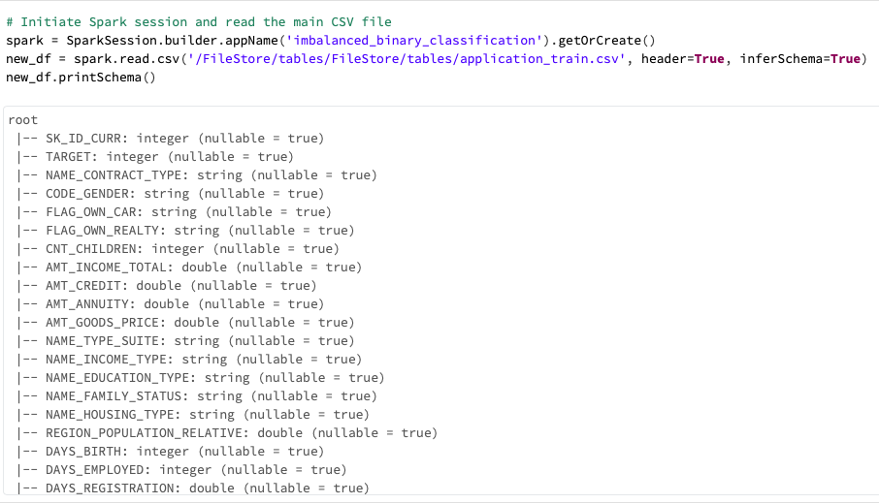
Initiating the Spark Session
Initiate the Spark Session.
Load and read the data file from DBFS in Databricks.
Analyze the structure of the dataset.
Project
Workflow
Exploration
Technology
Code
Modeling
Ref

Slide 7
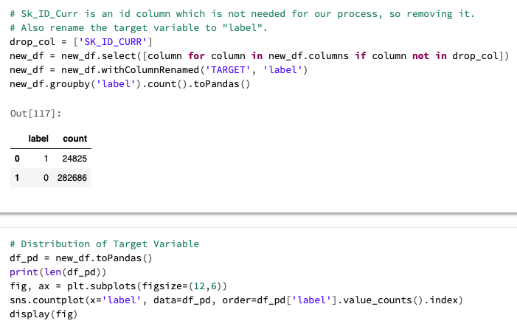
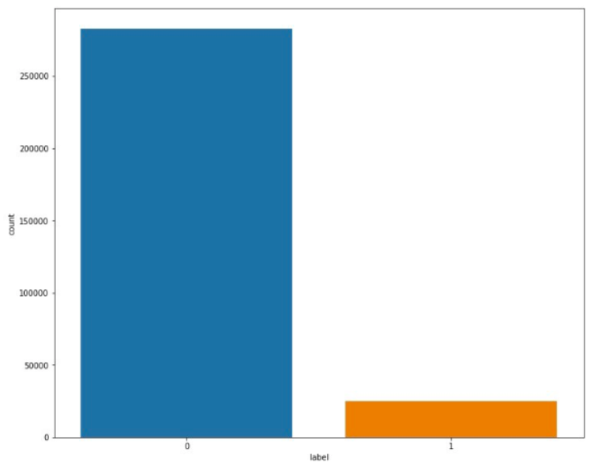
Visualizing the Distribution of the Target Variable
Project
Workflow
Exploration
Technology
Code
Modeling
Ref

Slide 8
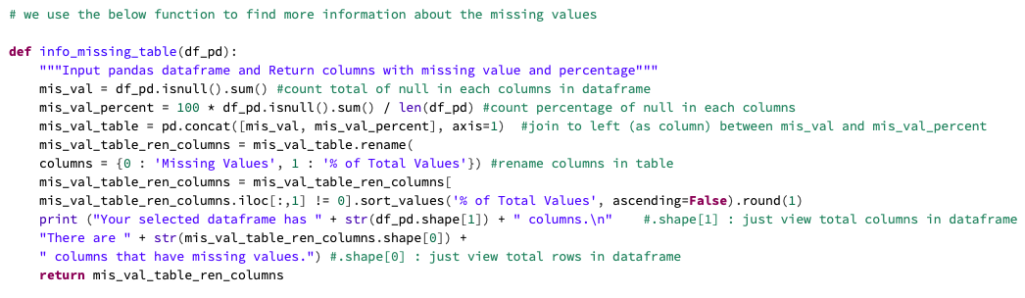
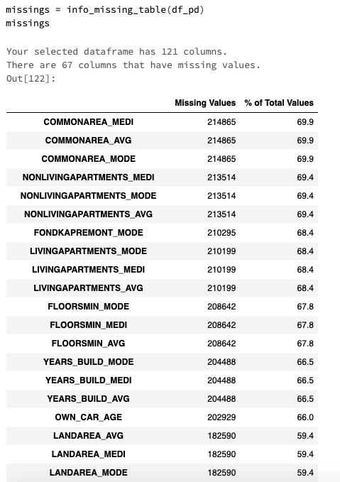
Data Wrangling
There are 67 columns out of 121 that has missing values in them and it doesn't show all of them in the image, but overall, most of these 67 columns have more than 50 percent missing values.
Fill the numerical missing values with the average of each column and the categorical missing values with the most frequent category of each column.
Project
Workflow
Exploration
Technology
Code
Modeling
Ref

Slide 9
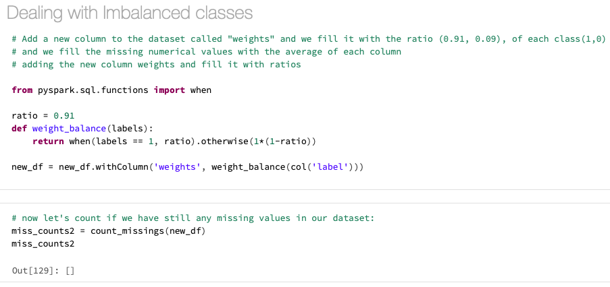
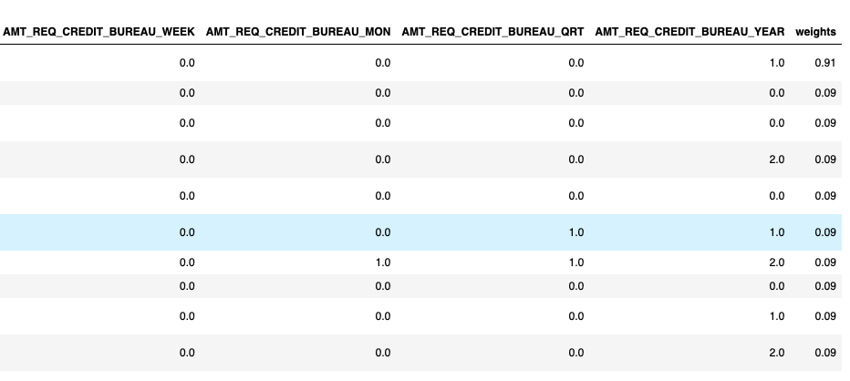
Dealing with Imbalanced Classes
Assign weights for each class to penalize the majority class by assigning less weight and boost the minority class by assigning bigger weight.
Create a new column in the dataset named “weights” and assign the inverse ratio of each class as weights.
Project
Workflow
Exploration
Technology
Code
Modeling
Ref

Slide 10
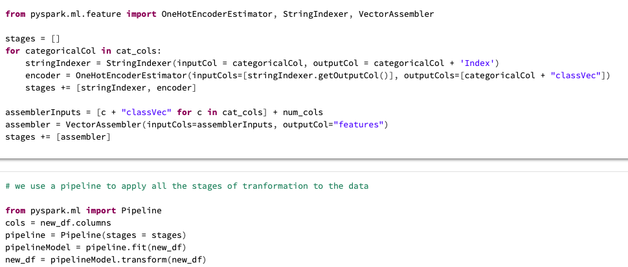
Feature Engineering
Use StringIndexer() to assign indices to each category in our categorical columns.
Apply OneHotEncoderEstimator() to convert categorical columns to onehot encoded vectors.
Apply VectorAssembler() to create a feature vector from all categorical and numerical features and we call the final vector as “features”.
Project
Workflow
Exploration
Technology
Code
Modeling
Ref

Slide 11
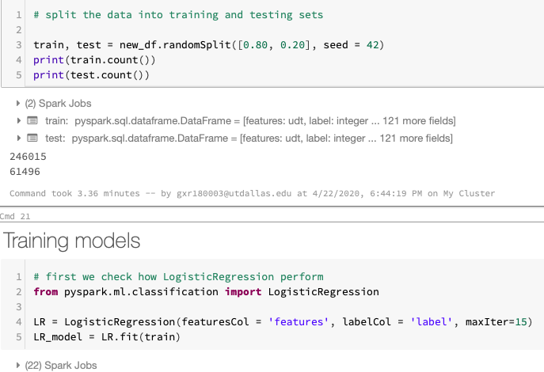
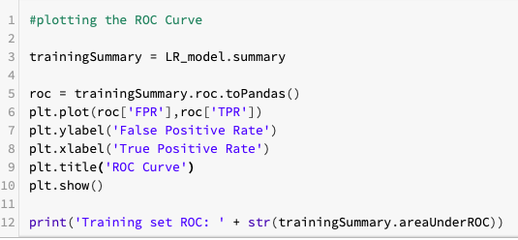
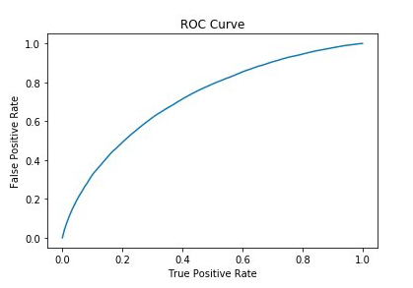
Modeling
Project
Workflow
Exploration
Technology
Code
Modeling
Ref

Slide 12
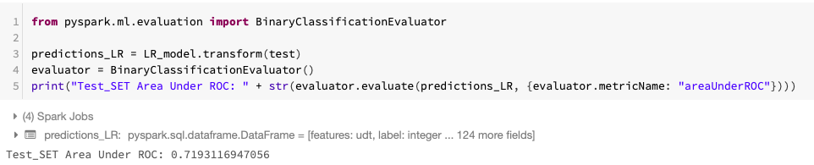
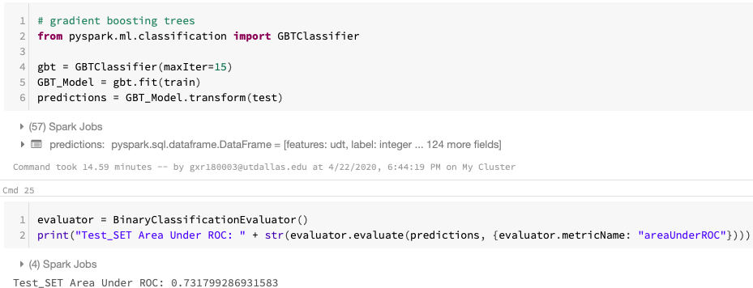
Modeling
Check the model’s performance on test set.
When using the Gradient Boosting trees, we get a better model performance (0.732).
Project
Workflow
Exploration
Technology
Code
Modeling
Ref

Slide 13
References
https://www.edureka.co/blog/pyspark-programming/
https://github.com/nxs5899/end-to-end-Machine-Learning-model-with-MLlib-in-pySpark/blob/master/MLlib_pySpark.ipynb
https://towardsdatascience.com/build-an-end-to-end-machine-learning-model-with-mllib-in-pyspark-4917bdf289c5
https://databricks.com/blog/2014/07/14/databricks-cloud-making-big-data-easy.html
https://www.kaggle.com/c/home-credit-default-risk/data
Project
Workflow
Exploration
Technology
Code
Modeling
Ref

Slide 14
THANK YOU

